Slide 1
Git
Fast, scalable, distributed revision control system
Thierry GAYET

Slide 2
Version Control Systems
Archive old versions of files and directories
Examine logs of how files have changed over time
Collaborate with people on documents (usually over a network) and keep track of who made which changes
CVS
SVN
Git
Bazaar
Mercurial (HG)
Clearcase (UCM)

Slide 6
Drawbacks of Lock-Modify-Unlock Solution
Administrative problems
Unnecessary serialization
A false sense of security

Slide 8
Git
Initially developed by Linus Torvalds
Distributed version control system (different branches hold different parts of the code)
Every Git working directory is a full-fledged repository with complete history
Projects using Git
Git
Linux Kernel
Perl
Gnome
Ruby on Rails
Android
Fedora
MeeGo
Debian
VLC

Slide 9
Protocols
Many protocols to transfer data between repositories
-rsync, http, https, git, ssh
In the core, git also has:
-import/export with CVS
-import/export with SVN
-import from Arch

Slide 11
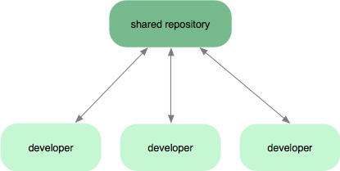
Subversion-Style Workflow
Centralized

Slide 12
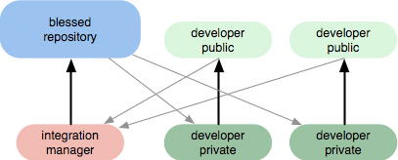
Integration Manager Workflow
Integration manager—a single person who commits to the 'blessed' repository
A number of developers who clone from that repository, push to their own independent repositories and ask the integrator to pull in their changes

Slide 15
Getting a repository
Git
$ git clone git://git.kernel.org/pub/scm/git/git.git
Linux kernel
$ git clone git://git.kernel.org/pub/scm/linux/kernel/git/torvalds/linux-2.6.git

Slide 16
Commits
Every change in the history of a project is represented by a commit. The git-show command shows the most recent commit on the current branch
$ git show
commit 17cf781661e6d38f737f15f53ab552f1e95960d7
Author: Linus Torvalds <torvalds@ppc970.osdl.org.(none)>
Date: Tue Apr 19 14:11:06 2005 -0700
Every commit has a 40-hexdigit id, called the "object name" or the "SHA-1 id”
We can also refer to a commit by a shorter name, such as a tag or a branch name

Slide 17
Naming Commits
40-hexdigit object name
branch name: refers to the commit at the head of the given branch
tag name: refers to the commit pointed to by the given tag
HEAD: refers to the head of the current branch
$ git show fb47ddb2 # the first few characters of the object name
# are usually enough to specify it uniquely
$ git show HEAD^ # the parent of the HEAD commit
$ git show HEAD^^ # the grandparent
$ git show HEAD~4 # the great-great-grandparent
Merge commits may have more than one parent.
$ git show HEAD^1 # show the first parent of HEAD
$ git show HEAD^2 # show the second parent of HEAD

Slide 18
Heads and Tags
Head is reference to the most recent commit
git-branch command shows the list of branch heads
$ git branch
* master
Tags are references into the project's history, and can be listed using the git-tag command
$ git tag -l
v2.6.11
v2.6.11-tree
v2.6.12
v2.6.12-rc2
v2.6.12-rc3
v2.6.13
Tags are expected to always point at the same version of a project, while heads are expected to advance as development progresses.

Slide 19
Checking out different versions of project
Make v2.6.12 the current branch, updating the working directory to reflect the version referenced by v2.6.12
$ git checkout v2.6.12
Create a new branch pointing to one of the versions and check it out using git-checkout command
$ git checkout -b new v2.6.13

Slide 20
Manipulating branches
git branch
list all branches
git branch <branch>
create a new branch named <branch>, referencing the same point in history as the current branch
git branch <branch> <start-point>
create a new branch named <branch>, referencing <start-point>, which may be specified any way you like, including using a branch name or a tag name
git branch -d <branch>
delete the branch <branch>

Slide 21
Understanding History
Every commit (except the very first commit in a project) also has a parent commit which shows what happened before this commit
Git allows lines of development to diverge and then reconverge
The point where two lines of development reconverge is called a "merge“
The commit representing a merge can therefore have more than one parent
o--o—o <-- Branch A
/
o--o--o <-- master
\
o--o--o <-- Branch B

Slide 22
Patches
$ git format-patch origin
It will produce a numbered series of files in the current directory
Git also provides a tool called git-am (am stands for "apply mailbox"), for importing such an emailed series of patches.
$ git am -3 patches.mbox

Slide 24
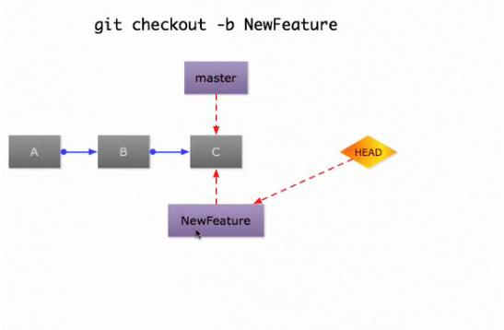

Slide 29
Example
Creating a new repository
From a tarball:
$ tar xzf project.tar.gz
$ cd project
$ git init
Initialized empty Git repository in the current dir
$ git add .
$ git commit
Creates a branch named “master”
HEAD points at “master”

Slide 30
Cloning the repository
$ git clone git://example.com/pub/project.git
$ cd project
Creates a git repo from an existing repo
Remote “HEAD” branch checked out as your initial “master” branch

Slide 31
Making Changes
Edit your files
Select file contents to include in the next commit, then make the commit:
$ git add a.txt # updated file
$ git add b.txt # new file
$ git rm c.txt # old file
$ git commit
Or, prepare and create the commit in one step:
$ git commit d.txt # use latest content only of d.txt
$ git commit -a # use latest content of all tracked files

Slide 32
Merging
$ git merge test
Merge branch "test" into the current branch
$ git pull git://example.com/project.git master
Fetch a branch in a different git repository, then merge into the current branch
$ git push ssh://example.com/project.git mybranch:theirbranch
After creating commits on a local branch, update the remote branch with your commits:

Slide 33
References
http://www.kernel.org/pub/software/scm/git/docs/user-manual.html
http://whygitisbetterthanx.com
http://git-scm.com
http://git.or.cz/course/svn.html

